Slide 1
DoorDash Project scenarios
Developing the product
Product Owner: [Reham Dakhel Almaghathawi]
© 2019 Udacity. All rights reserved.

Slide 2
Getting Started

Slide 3
Create Project Blueprint
A product launch is not just about deploying a beautifully designed,built and thoroughly tested feature. Your company needs to be equally prepared if not more to support every possible customer interaction associated with the product (e.g landing on your company website to learn more about the new feature)
© 2019 Udacity. All rights reserved.
Notes:
[ALL PARTICIPATION]

Slide 4
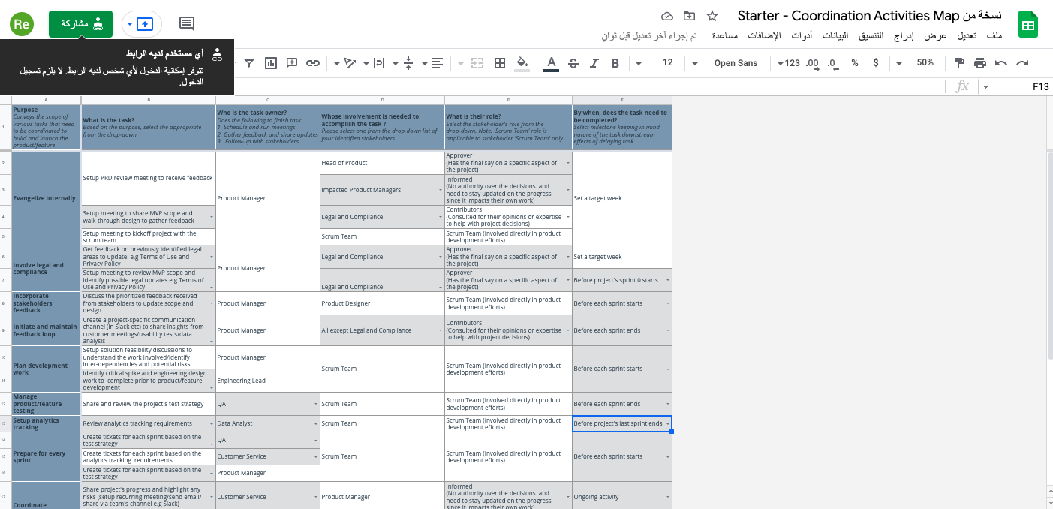
Create a coordination activities map
Activites Map

Slide 5
Plan for Sprint Meeting
As a PM, it is important to stay ahead of your scrum team and be prepared for every upcoming sprint by having a target goal defined with prioritized backlog for team to start costing and breaking down the tasks
© 2019 Udacity. All rights reserved.
Notes:
[ALL PARTICIPATION]

Slide 6
Sprint Planning Meeting Preparation
Sprint Goal
operations improvement to build better delivery food robots
Sprint Backlog
1 | As a consumer I want to be an ability to find more options when I have problems in receiving order
2 | As a consumer I want to be an ability to get notifications when the robot gets the wrong address
3 | As a customer, I would want more payment and delivery method alternatives.
4 | As a product manager, I'd like to work with the product marketing and Development teams to add certain features to this product in order to increase the number of users. ”Rewards”
5 | Adding a marketing method by sharing a code with the user's friends and acquaintances to receive a free service or credit to the user's wallet via our application, which is done by the marketing and operations teams in collaboration with the Finance and Accounting teams. “invite a friend”
Sprint Prioritization Logic
These are the key elements of operations enhancement to create better delivery food robots.
© 2019 Udacity. All rights reserved.

Slide 7
User Story 1
User Story | As a product manager, I'd like to work with the product marketing and Development teams to add certain features to this product in order to increase the number of users. ”Rewards”
Design | Prototype Rewards
Acceptance Criteria | Usability Requirements: A logged in user can find the newly added function clicking and displaying a list from the left button above, then you can click on ”DashRewards." Non-functional requirements: The page will continue to be mobile responsive and ADA compliant. Platform: The user can manage the process via multiple platforms such as browser, device, app store etc Auditability: The usage of function requires an acceptance of terms and conditions by the user. Internationalization: must support multiple languages
Assumptions | The feature of Robodash is available for trips by Robodash and Dashers delivery The users will receive a Rewards as amount or discounts
© 2019 Udacity. All rights reserved.

Slide 8
User Story 2
User Story | Adding a marketing method by sharing a code with the user's friends and acquaintances to receive a free service or credit to the user's wallet via our application, which is done by the marketing and operations teams in collaboration with the Finance and Accounting teams. “invite a friend”
Design | Prototype Invite Friend
Acceptance Criteria | Usability Requirements: A logged in user can find the newly added function clicking and displaying a list from the left button above, then you can click on "invite a friend.” Non-functional requirements: The page will continue to be mobile responsive and ADA compliant. Platform: The user can manage the process via multiple platforms such as browser, device, app store etc Auditability: The usage of function requires an acceptance of terms and conditions by the user. Internationalization: must support multiple languages
Assumptions | The feature of Robodash is available for trips that are less than 2 miles only and the MVP will be launched in multiple languages
© 2019 Udacity. All rights reserved.

Slide 9
Decoding API Documentation
As a PM, you will collaborate with the engineering team and provide guidance that heavily influences their development approach. When a product requires an API integration, sometimes PM need to be “technical enough” to understand the following to refine the solution with designer and development team
what information is available via the API
how is it available
possible pricing impact
© 2019 Udacity. All rights reserved.
Notes:
[ALL PARTICIPATION]

Slide 10
< Insert Name>Project
Based on the API documentation how would you update your solution and design? | For more information about the Directions API's quotas and pricing, go to the usage and billing page. The API regulations must be followed when using the Directions API. Use HTTPS instead of HTTP.
Based on your high-level understanding of the API documentation, are there any details that you want to discuss with engineering to refine solution and/or determine feasibility | You must first enable the Directions API and receive the appropriate authentication credentials before using it. What users are going to use? python vs. java vs. js. vs. go?

Slide 11
Re-prioritize Sprint Backlog
As a PM, unexpected issues and new feature requests will require you to triage them efficiently and re-prioritize the sprint backlog without impacting the roadmap deliverables significantly
© 2019 Udacity. All rights reserved.
Notes:
[ALL PARTICIPATION]

Slide 12
Issue 1: Landing Page loading too slow
Determine impact and criticality to prioritize issue | Ticket Read Bug Client feedback read give it a shot
Next Steps | When comparing loading time to acceptance criteria, I would reprioritize to 2 because the page is operational and the delay is not critical. Consult with QA team: Is there a problem on all systems? When was it? Request a suggested repair. Meeting with the scrum team and discuss complications with updates and figure out what happened and how to prevent it from happening again Preparing Jira ticket for the next sprint
Would you take additional steps ? | collaborating with the development team to update the definition of done so that the loading time is monitored on a regular basis and does not decline.
© 2019 Udacity. All rights reserved.

Slide 13
Issue 2: Misaligned fields in Profile Settings
Determine impact and criticality to prioritize issue | As with any new product, the bug has a priority of 3- Normal, which I would raise to 3 - Normal. The options panel appears to be faulty, and the user may lose faith in the functioning, quality, or security of the product.
Next Steps use ticketing tool (JIRA), and communication channel (Slack) | Check and update the displays with the Ul and UX designer teams. Get a Jira ticket ready fort he development team asking the Q/A team to provide me with information on where and why this problem is occurring. Timetable and plan of the luncheon.
© 2019 Udacity. All rights reserved.

Slide 14
Respond to Customer Service Manager’s Email
Determine impact and criticality to prioritize the issue | according to the total number, A large number of customers are affected,- It is very critical -priority setting is 1 Critical It necessitates a significant amount of our teams. feeling totally frustrating with the customer 100% of the time, 12hours fails to meet the acceptance criterion.
Next Steps | Find a way to stop the current sprint. As soon as possible, call an emergency meeting with development and QA teams Make a quick plan to deal with the situation right now and how to resolve it.
Sample Email Response | Good day dear Dana We express our heartfelt apologies. And we thank you for the lengthy delay; we understand the significance of this issue. We have dedicated all of our resources to resolving the issue. Please visit our app without signing up for the time being while we work on a solution to this problem. I'll keep you informed of our progress. Please let me know if you have any additional concerns. Best wishes. Customer Service Sarah Kim
© 2019 Udacity. All rights reserved.

Slide 15
Handle Potentially Difficult Situations
As a PM, you will be faced with many unexpected situations where you have to make a decision or push back while managing competing priorities from stakeholders and tackling issues that could potentially affect your product launch
© 2019 Udacity. All rights reserved.
Notes:
[ALL PARTICIPATION]

Slide 16
Respond to CEO or GM’s request via email
Assessment and result | notify the teams I prepare for the event by telling stories and communicating with developers about the presented features, as a PM So, at this point, a review in front of the CEO/GM is not a big deal.
Sample Email Response | To dear William CEO-GM We will be happy to introduce you to our work, …I suggest that you participate in our regular review a few days later We can keep our schedule in this way and not lose traction. Bear in mind that you will see the latest work underway and bugs in this state are unavoidable. We look forward to hearing from you. If the alternative date works for you, please let me know. If further clarification is needed, let me know. I'd be delighted to assist. Thank you very much. Good wishes. Reham Dakheel Almghathawi
© 2019 Udacity. All rights reserved.

Slide 17
Step-in and guide the scrum team at stand up
Video Response | Share the link to your video here insert link
© 2019 Udacity. All rights reserved.

Slide 18
Handling Resource Constraints
List 2- 3 activities that you would carry out as a PM to unblock the scrum team immediately ? | Inquire with the Head of QA for assistance The PM can perform manual verification and regression for user stories that have been completed by that point. Inquire about the team's test automation experience and knowledge.
Since the QA team member is shared across multiple projects, how would you coordinate with other PMs to de-risk your project and raise appropriate visibility ? | Describe the significance of my project. Consult with all affected PMs. Finding an easy deal. If no agreement is reached, the next person in the hierarchy is asked to make a decision.
Since there is a potential risk, it is important to raise visibility amongst appropriate stakeholders | I work with other people on a professional level. If something about the outcome does not suit me, I express my unhappiness and call a meeting with the other PMs to discuss how to handle similar circumstances in the future.
 | All stakeholders should be identified from the outset of the project, with the Head of Quality Assurance being the person in charge. A scrum team should have all knowledge team members, including myself, taught to prevent being dependant on others and PMs involved team members.
© 2019 Udacity. All rights reserved.

Slide 19
How would you handle stakeholder feedback?
Feedback Assessment | Is it appropriate to start with the MVP to assist us understand the customer path and then add notifications later? Are the notifications critical to the product's success? What if the notifications aren't working?
Video Response | Share the link to your video here insert link
© 2019 Udacity. All rights reserved.

